Slide 1
Hierarchical Attention Network for Image Captioning
Weixuan Wang et al.
Sun Yat-sen University
AAAI 2019

Slide 2
Problems
Only established on low-level spatial features or high-level text features. However, different words in description sentence are relevant to features of different levels.
Notes:
For example, the color words could be predicted by low-level features and the quantifier could be generated by mid-level features.

Slide 3
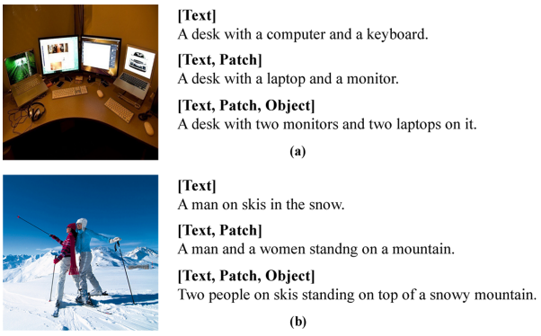
Hierarchy feature pyramid
captions generated by features of different levels.

Slide 4
Text features
semantically strong text features
refer to semantic concepts related to images, including adjectives, verbs, and nouns. the semantic concepts are converted to text features via the Embedding function
construct a K=2000 classification text predictor. take 10 text concepts with the highest score for an image.

Slide 5
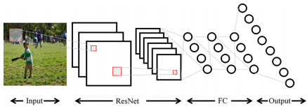

Text predictor
structure diagram
objective function
Notes:
N represents the number of texts and the p∗i is 1 if the corresponding word exists in the groundtruth.

Slide 6
Patch features
semantically weak patch features
refer to the abstract feature expression of each patch in an image.
utilize a Resnet101 pre-trained on ImageNet to extract 196 features of the last convolution layer as patch features

Slide 7
Object features
semantically moderate features
refer to the feature representation of salient objects.
introduce the Faster RCNN to capture objects. take 15 object features with the highest confidence.

Slide 8
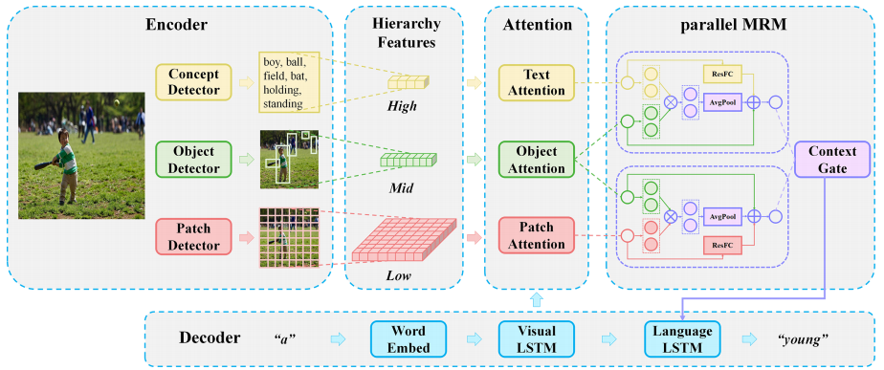
HAN
Hierarchical Attention Network

Slide 9
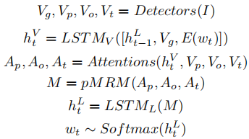
HAN
Formulas

Slide 10


Attention module
construct three independent attention networks on three levels for refining features.
V: the features of one level

Slide 11
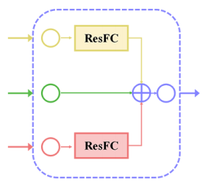


Multivariate Residual Module
integrate information of different modalities.
consists of a projection part and a relation part.
Projection part projects the patch attention feature and the text attention feature into the object space:

Slide 12
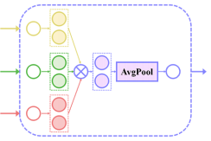


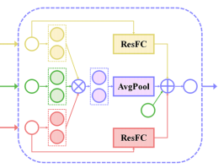
Multivariate Residual Module
Relation part exploits the inherent relationship among diverse spaces:
MRM
M = H + R

Slide 13
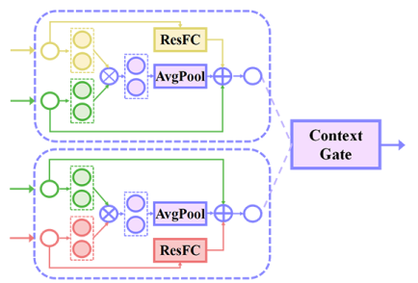



Multivariate Residual Module
pMRM (parallel MRM)
M_{L}: low-level attended features
M_{H}: high-level attended features
Notes:
The neuroscience (Ungerleider and Haxby 1994) proves that there is a content pathway in the brain for responding selectively to relevant object identification, and a position pathway for responding selectively to spatial aspects of stimuli.
pMRM first provide the object information to the text features and the patch features. Then a context gate is introduced to selectively focus on high-level content features and low-level position features.

Slide 14

Objective
cross entropy loss (XE)
CIDEr optimization (RL)

Slide 15
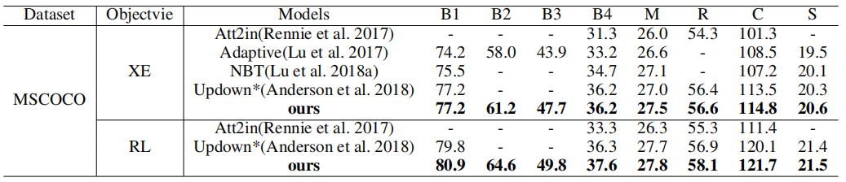
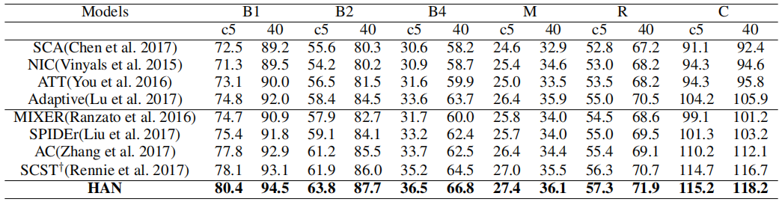
Results
MSCOCO Karpathy's test split
online MSCOCO test server

Slide 16
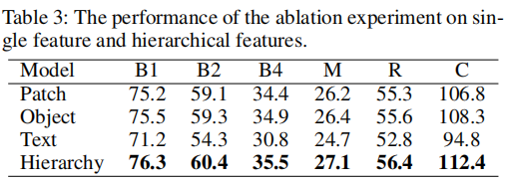
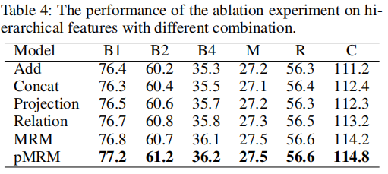
Ablation study

Slide 17
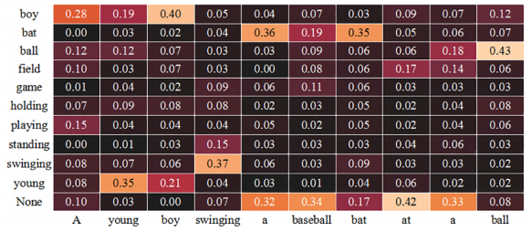
Qualitative Analysis
The visualization of text attention.

Slide 18
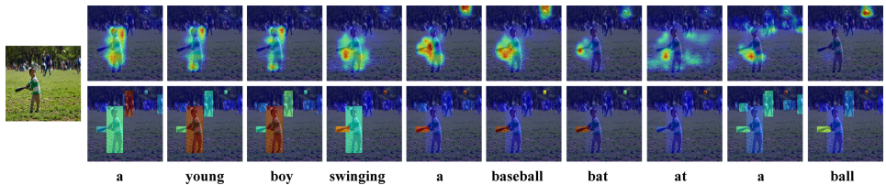
Qualitative Analysis
The visualization of patch attention(top) and object attention (bottom). The red and blue color represent the highest and lowest score respectively.

